Slide 1
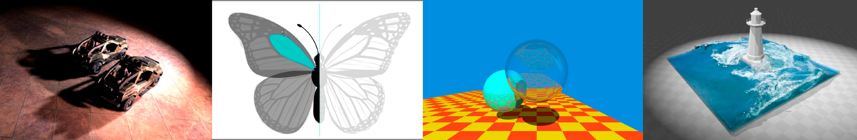
Introduction to Computer Graphics
Lecture 5:
Rasterization 1 (Triangles)
http://www.cs.ucsb.edu/~lingqi/teaching/games101.html

Slide 2
Last Lecture
Viewing transformation
-
-
View / Camera transformation
Projection transformation
-
-
Orthographic projection
Perspective projection
2

Slide 3
Today
Finishing up Viewing
- Viewport transformation
Rasterization
-
-
Different raster displays Rasterizing a triangle
Occlusions and Visibility
3

Slide 4
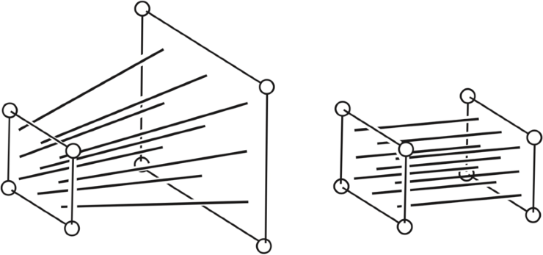
Perspective Projection
What’s near plane’s l, r, b, t then?
If explicitly specified, good
Sometimes people prefer: vertical field-of-view (fovY) and aspect ratio
(assume symmetry i.e. l = -r, b = -t)
width
Vertical Field of View
(fovY)
height
Aspect ratio = width / height
4

Slide 5
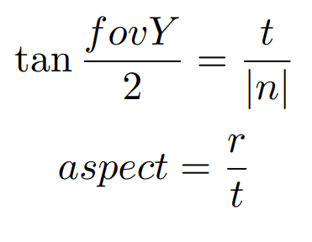


Perspective Projection
How to convert from fovY and aspect to l, r, b, t?
- Trivial
Y
(0, t, n)
Z
fovY / 2
|n|
5

Slide 6
What’s after MVP?
Model transformation (placing objects)
View transformation (placing camera)
Projection transformation
-
-
Orthographic projection (cuboid to “canonical” cube [-1, 1]³) Perspective projection (frustum to “canonical” cube)
Canonical cube to ?
6

Slide 7
Canonical Cube to Screen
What is a screen?
An array of pixels
Size of the array: resolution
A typical kind of raster display
Raster == screen in German
Rasterize == drawing onto the screen
Pixel (FYI, short for “picture element”)
For now: A pixel is a little square with uniform color
Color is a mixture of (red, green, blue)
7

Slide 8




Canonical Cube to Screen
Defining the screen space
- Slightly different from the “tiger book”
Pixels’ indices are
in the form of (x, y), where both x and y are integers
Y
array of pixels
Pixels’ indices are from
(0, 0) to (width - 1, height - 1)
Pixel (x, y) is centered at (x + 0.5, y + 0.5)
The screen covers range (0, 0) to (width, height)
(0, 0)
X
8

Slide 9
Canonical Cube to Screen
Irrelevant to z
Transform in xy plane: [-1, 1]² to [0, width] x [0, height]
Y
array of pixels
y
x
z
(0, 0)
X
9

Slide 10
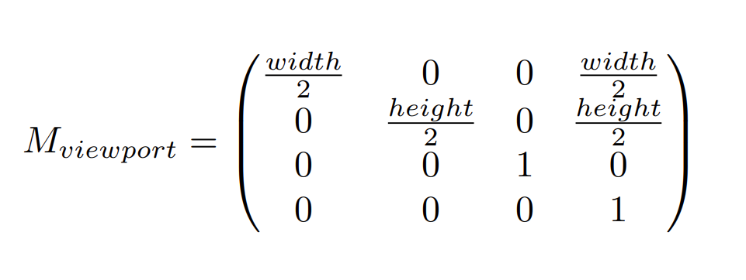
Canonical Cube to Screen
Irrelevant to z
Transform in xy plane: [-1, 1]² to [0, width] x [0, height]
Viewport transform matrix:
10

Slide 11
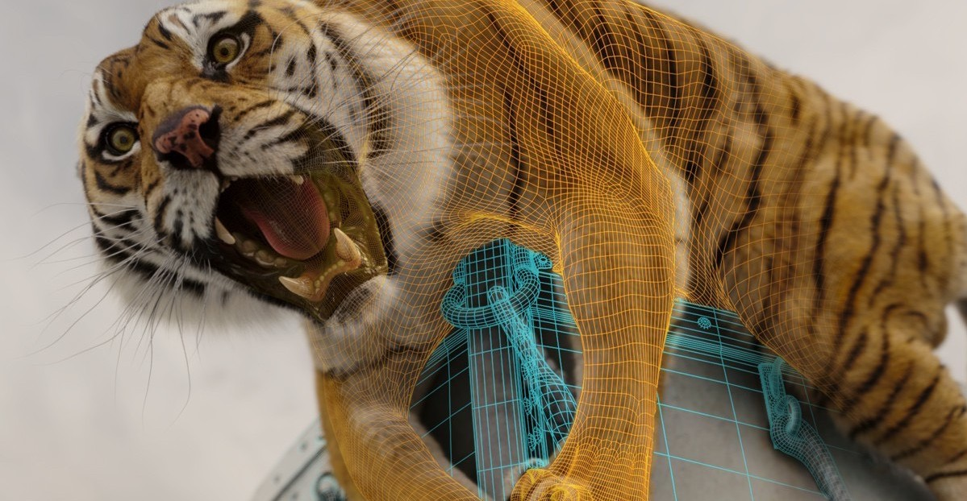
Next: Rasterizing Triangles into Pixels
Life of Pi (2012)
11

Slide 12
Drawing Machines
12

Slide 13
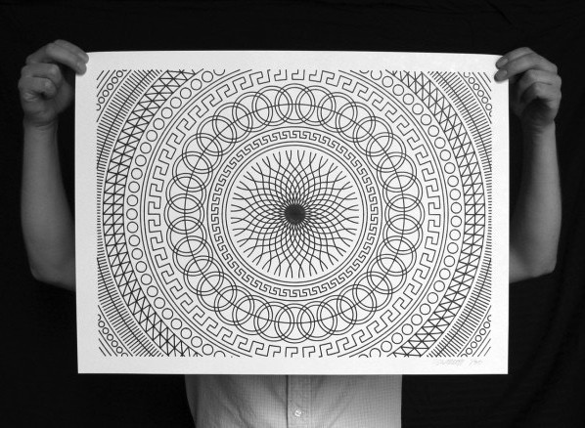
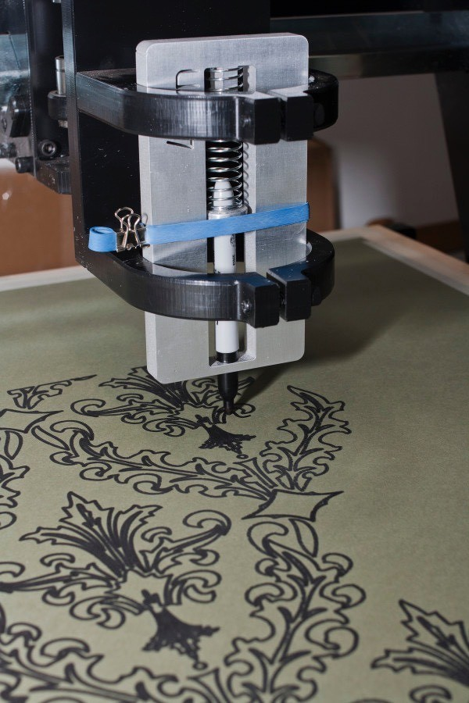
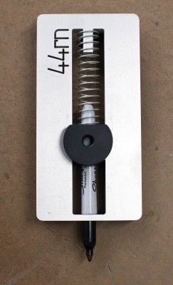
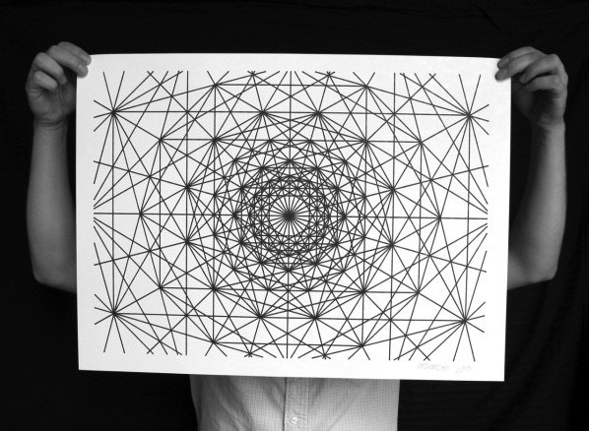
CNC Sharpie Drawing Machine
Aaron Panone with Matt W. Moore
http://44rn.com/projects/numerically-controlled-poster-series-with-matt-w-moore/
13

Slide 14
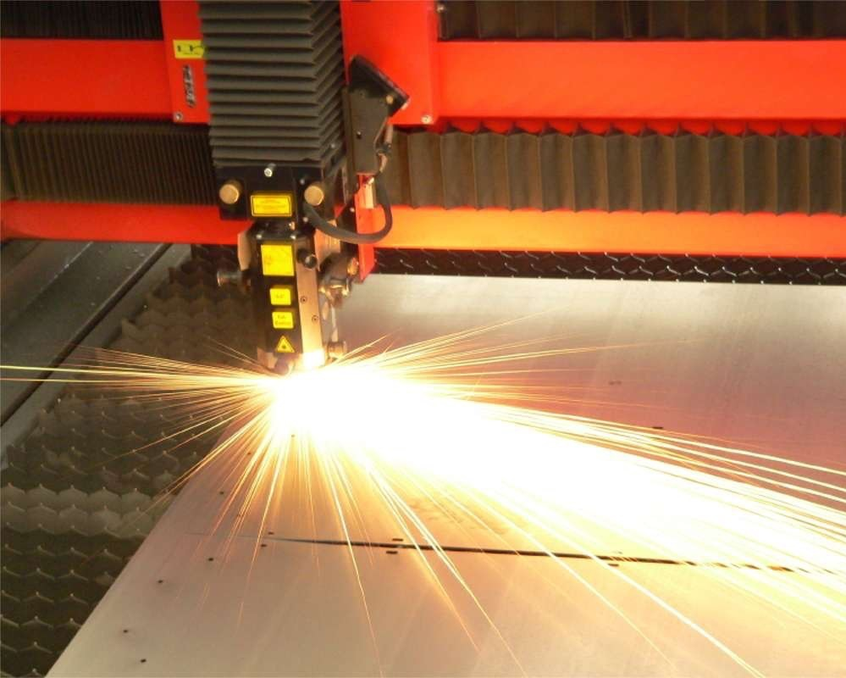

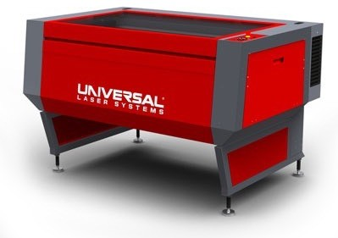
Laser Cutters
14

Slide 15
Different Raster Displays

Slide 16
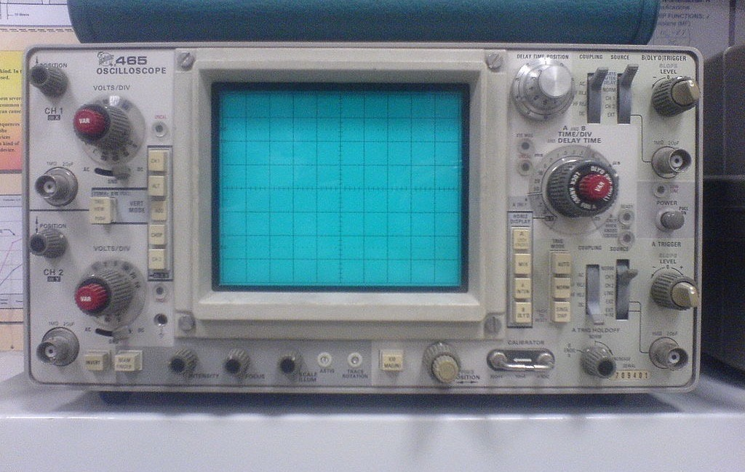
Oscilloscope

Slide 17
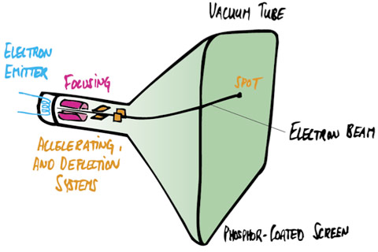
Cathode Ray Tube

Slide 18
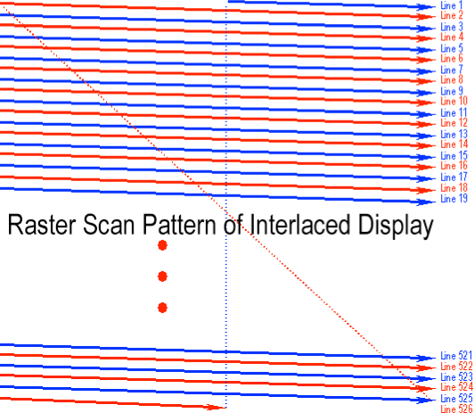
Television - Raster Display CRT
Raster Scan (modulate intensity)
Cathode Ray Tube

Slide 19
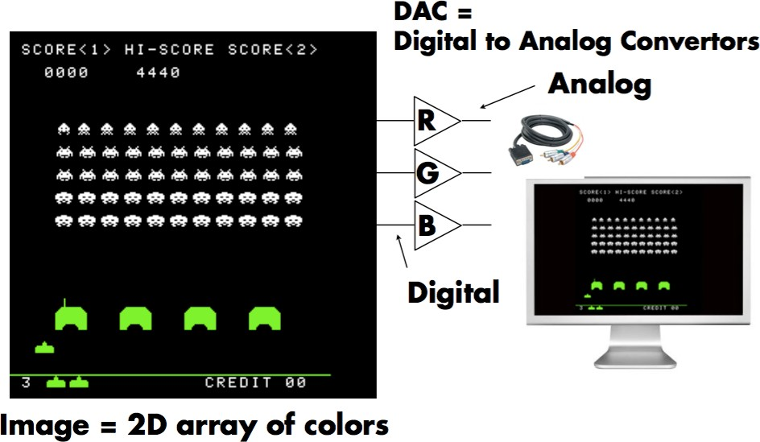
Frame Buffer: Memory for a Raster Display

Slide 20
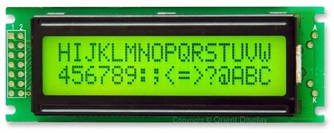
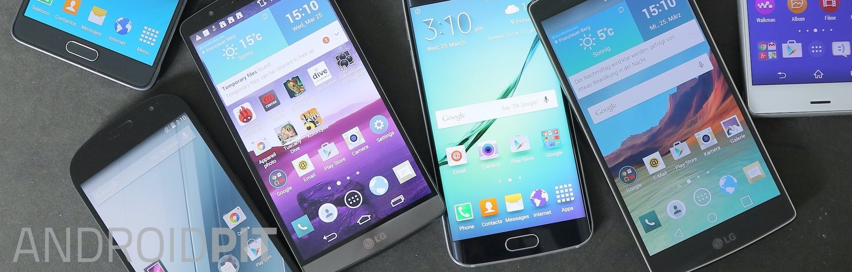
Flat Panel Displays
Low-Res LCD Display
B.Woods, Android Pit
Color LCD, OLED, …

Slide 21
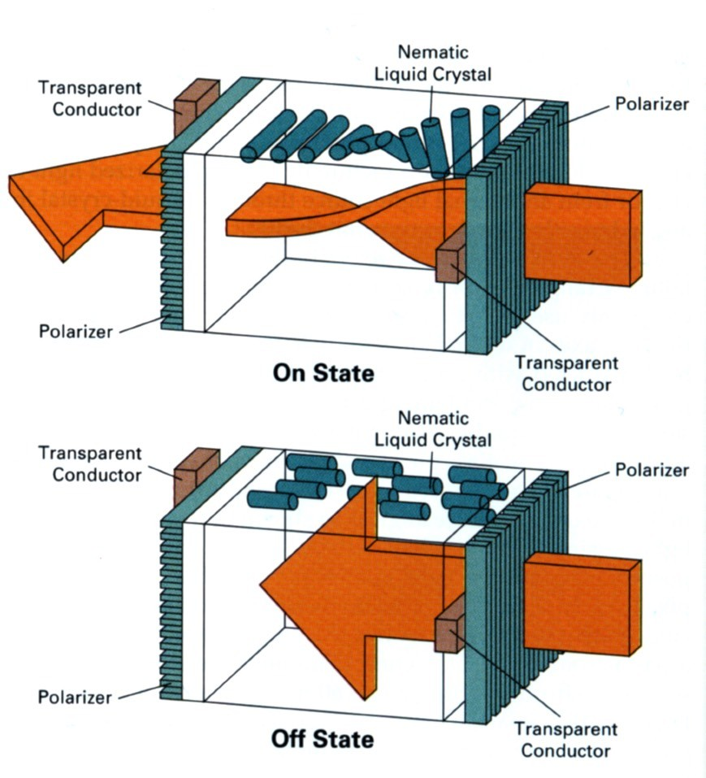
LCD (Liquid Crystal Display) Pixel
Principle: block or transmit light by twisting polarization
Illumination from backlight (e.g. fluorescent or LED)
Intermediate intensity levels by partial twist
[H&B fig. 2-16]

Slide 22
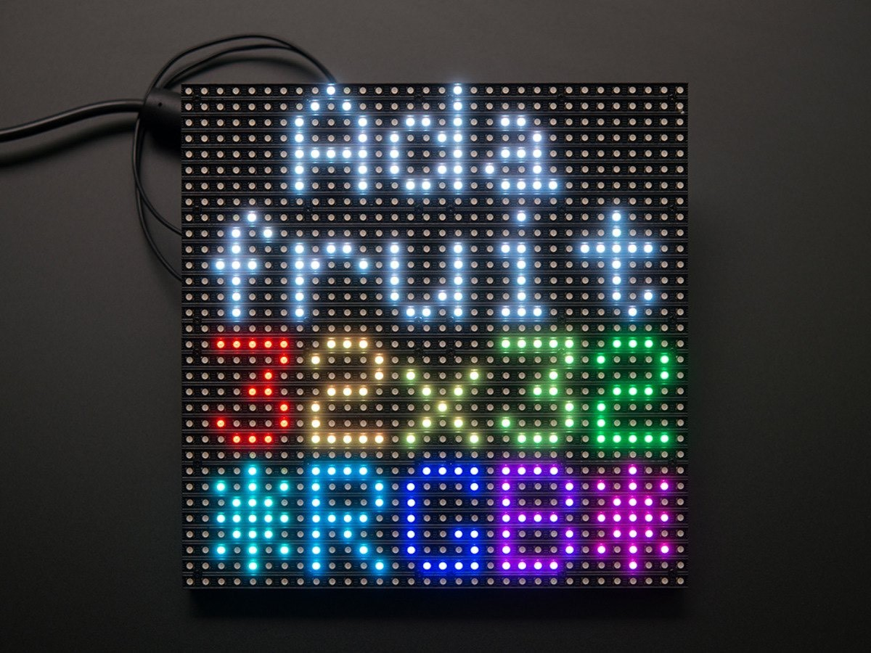
LED Array Display
Light emitting diode array

Slide 23
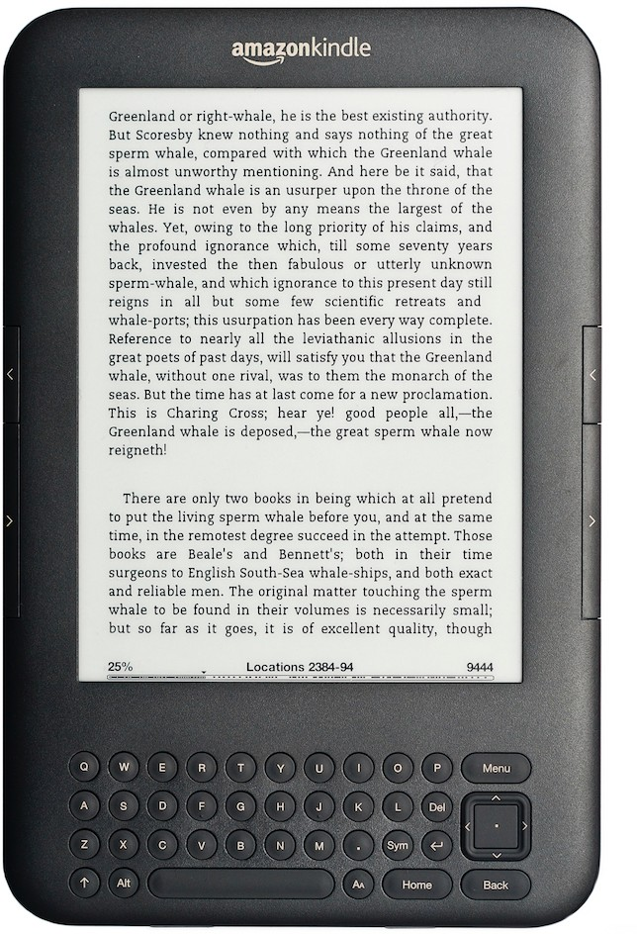
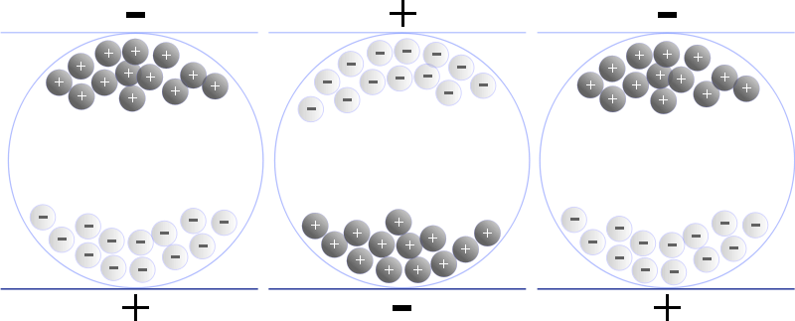
Electrophoretic (Electronic Ink) Display
[Wikimedia Commons
—Senarclens]

Slide 24
Rasterization: Drawing to Raster Displays

Slide 25
Polygon Meshes
Life of Pi (2012)

Slide 26
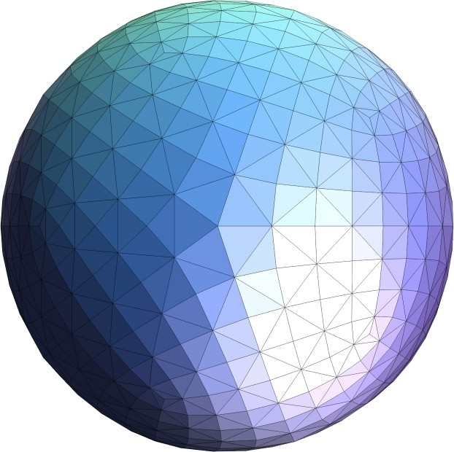
Triangle Meshes

Slide 27

Triangle Meshes

Slide 28
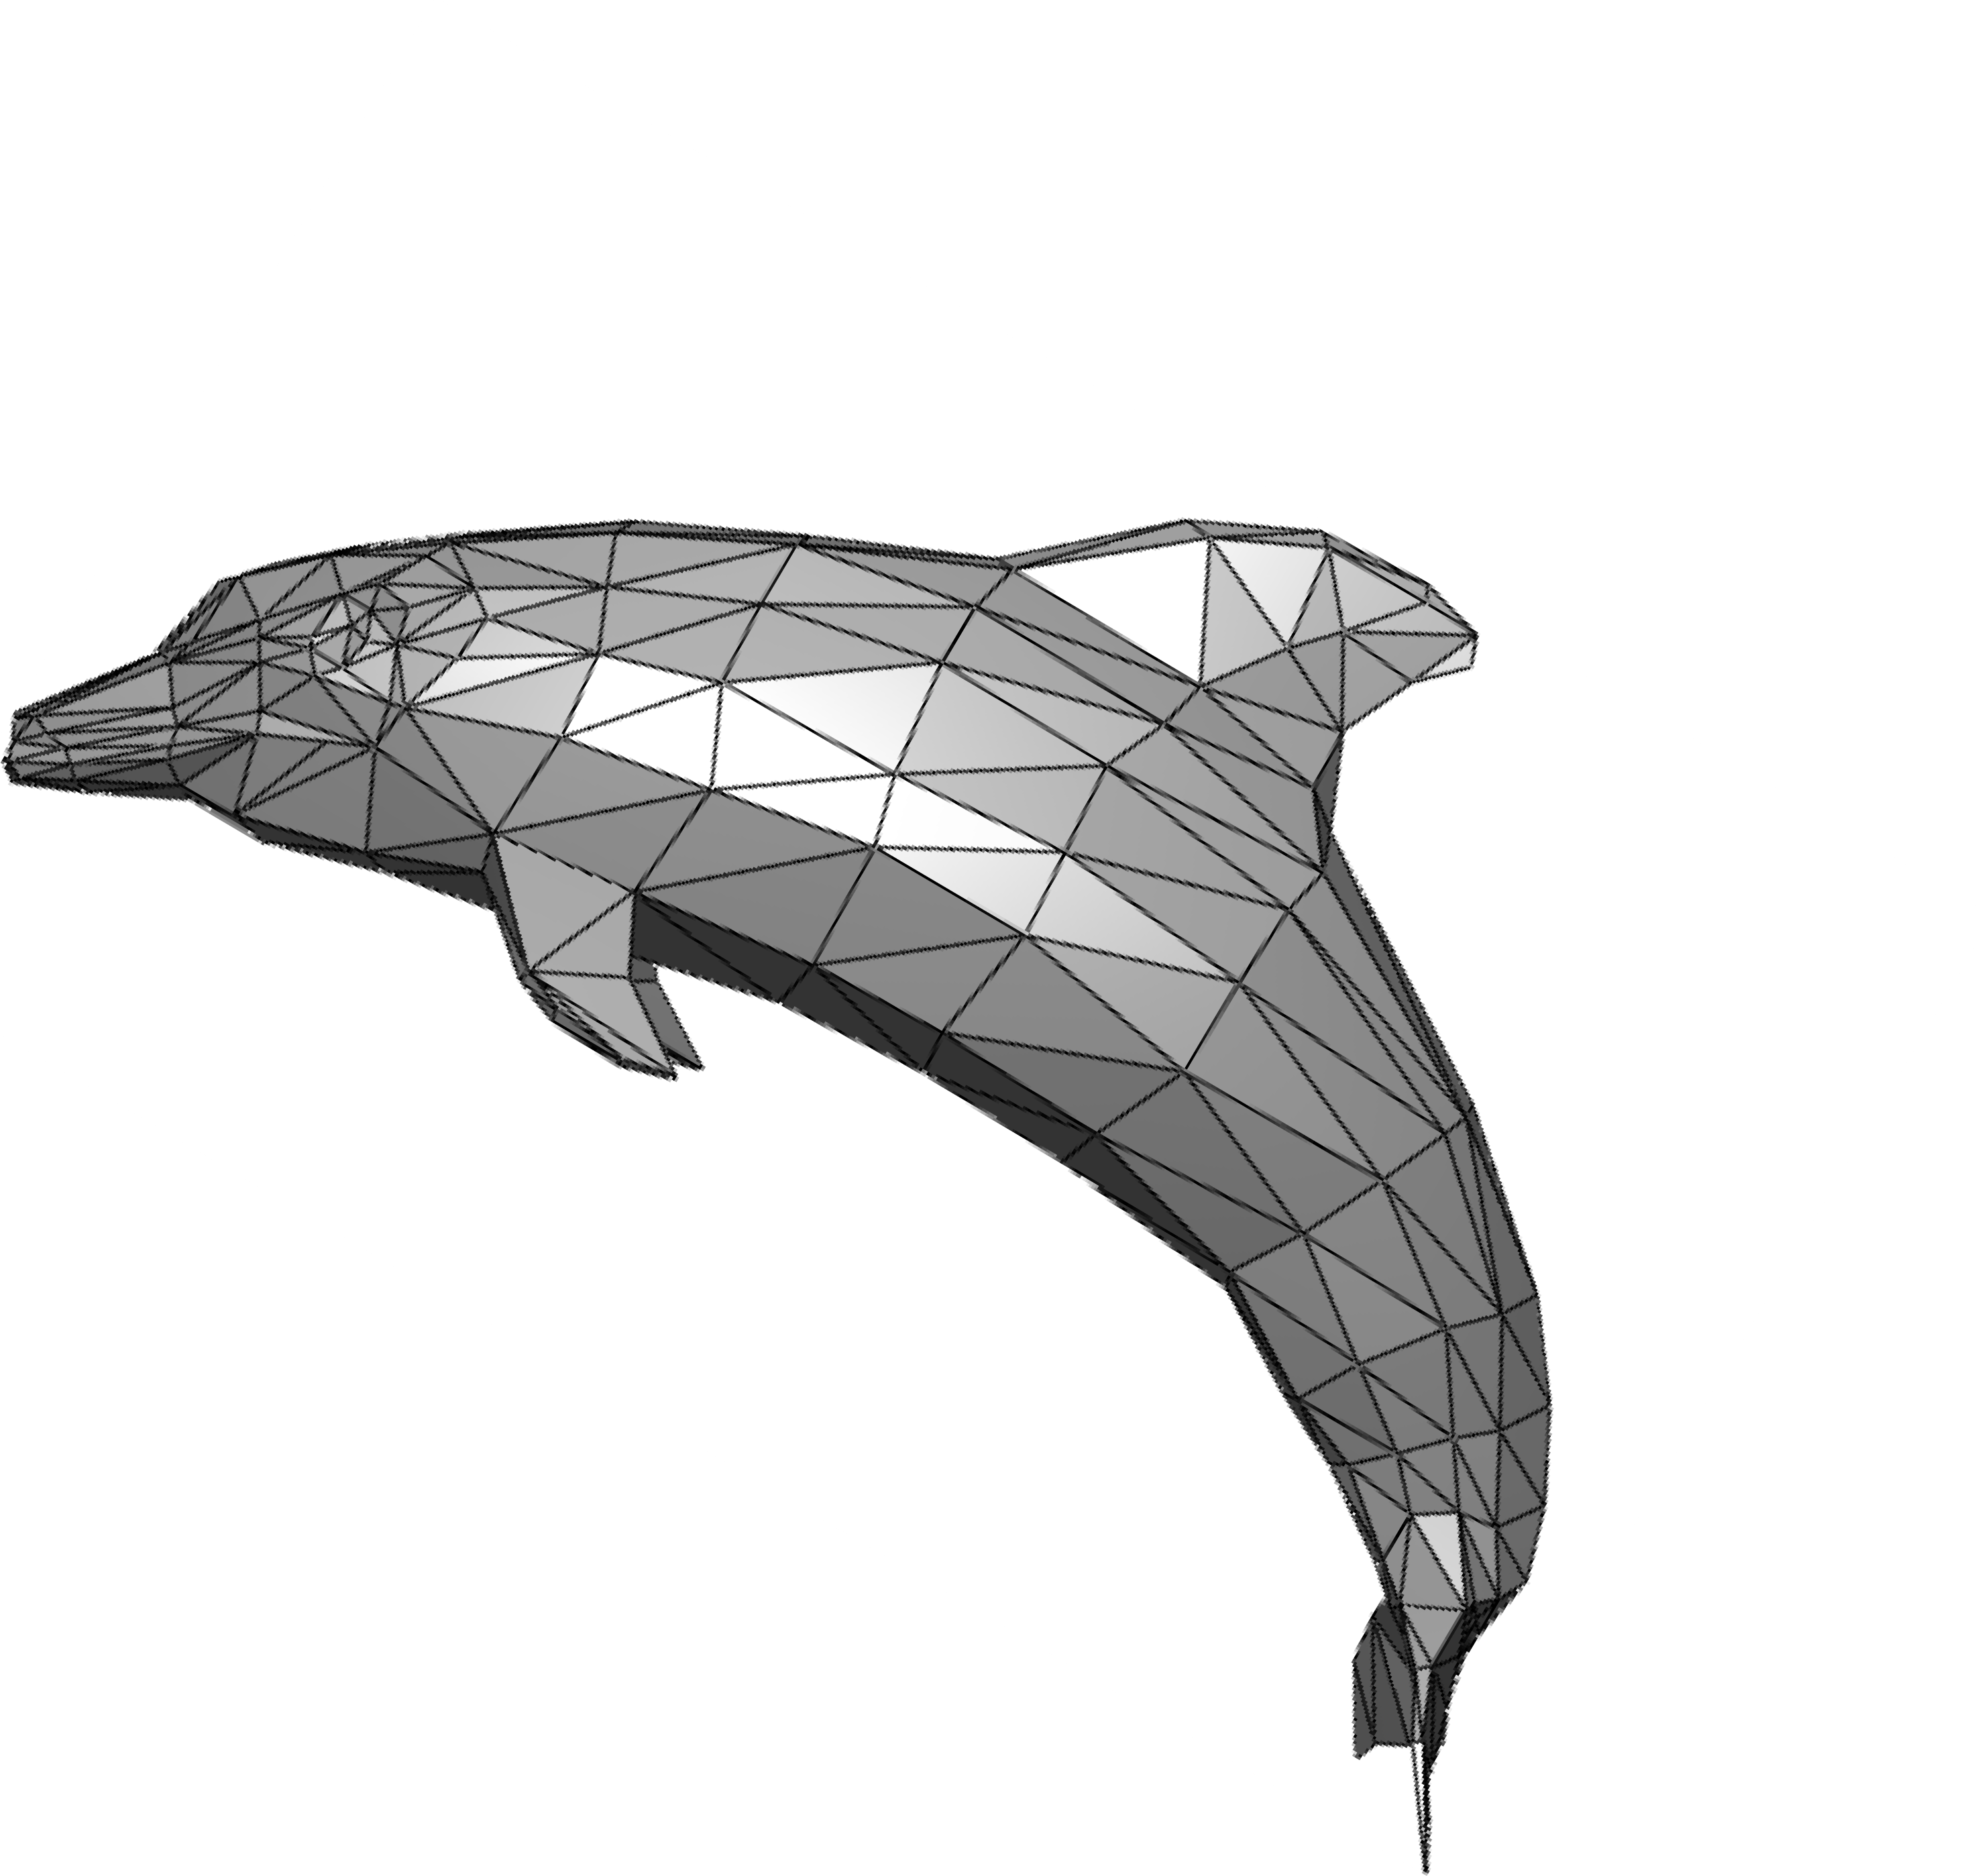
Triangles - Fundamental Shape Primitives
Why triangles?
Most basic polygon
Break up other polygons
Unique properties
Guaranteed to be planar
Well-defined interior
Well-defined method for interpolating values at vertices over triangle (barycentric interpolation)

Slide 29
What Pixel Values Approximate a Triangle?
(2.2, 1.3)
?
(15.3, 8.6)
(4.4, 11.0)
Input: position of triangle vertices projected on screen
Output: set of pixel values approximating triangle

Slide 30
A Simple Approach: Sampling

Slide 31
Sampling a Function
Evaluating a function at a point is sampling. We can discretize a function by sampling.
for (int x = 0; x < xmax; ++x) output[x] = f(x);
Sampling is a core idea in graphics.
We sample time (1D), area (2D), direction (2D), volume (3D) …

Slide 32
Rasterization As 2D Sampling

Slide 33









Sample If Each Pixel Center Is Inside Triangle

Slide 34
Sample If Each Pixel Center Is Inside Triangle

Slide 35
Define Binary Function: inside(tri, x, y)
x, y: not necessarily integers
Point (x, y) in triangle t
1
inside(t, x, y) =
0 otherwise

Slide 36
Rasterization = Sampling A 2D Indicator Function
for (int x = 0; x < xmax; ++x) for (int y = 0; y < ymax; ++y)
image[x][y] = inside(tri,
x + 0.5,
y + 0.5);

Slide 37








Recall: Sample Locations
(0,h)
(w,h)
 |  |  | (x | +0.5, | y+0.5)
(0,0)
(w,0)
Sample location for pixel (x, y)

Slide 38
Evaluating inside(tri, x, y)

Slide 39
Inside? Recall: Three Cross Products!
P₂
Q
P₁
P₀

Slide 40

Edge Cases (Literally)
Is this sample point covered by triangle 1, triangle 2, or both?
2
1

Slide 41
Checking All Pixels on the Screen?
 |  |  |  |  |  | P | 2
P1
P0
Use a Bounding Box!

Slide 42

Incremental Triangle Traversal (Faster?)
P2
P1
P0
suitable for thin and rotated triangles

Slide 43
Rasterization on Real Displays

Slide 44

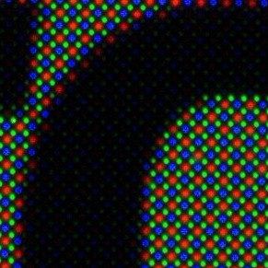
Real LCD Screen Pixels (Closeup)
iphonearena.com
iphonearena.com
iPhone 6S Galaxy S5
Notice R,G,B pixel geometry! But in this class, we will assume a colored square full-color pixel.

Slide 45
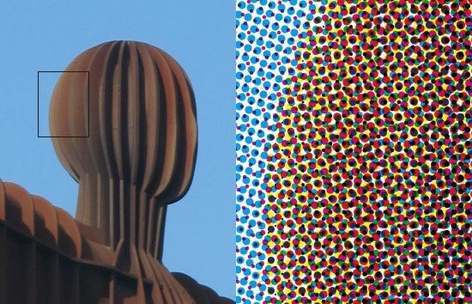
Aside: What About Other Display Methods?
Color print: observe half-tone pattern

Slide 46
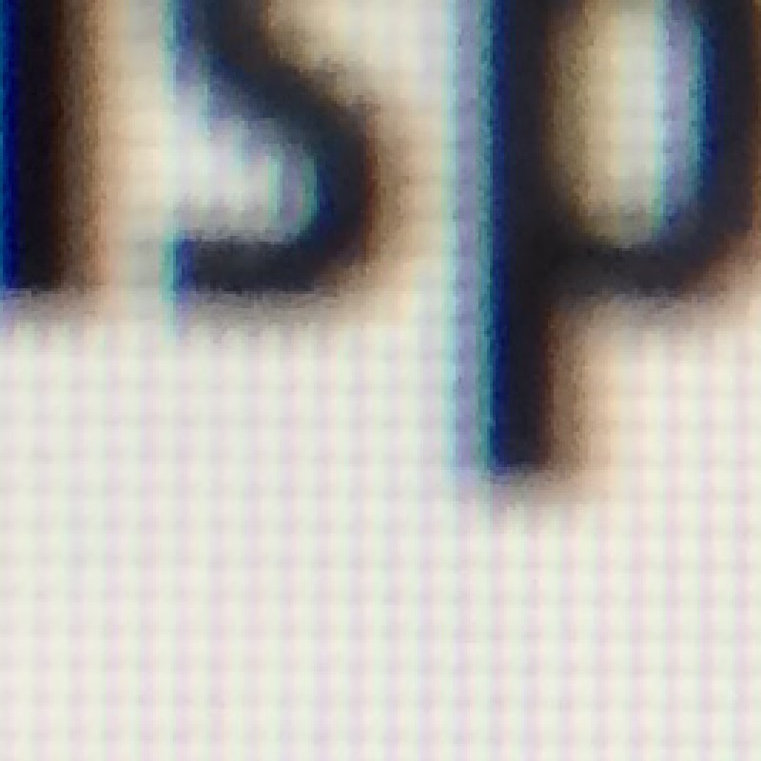
Assume Display Pixels Emit Square of Light
LCD pixel on laptop
* LCD pixels do not actually emit light in a square of uniform color, but this approximation suffices for our current discussion

Slide 47
So, If We Send the Display the Sampled Signal

Slide 48
The Display Physically Emits This Signal

Slide 49
Compare: The Continuous Triangle Function

Slide 50
What’s Wrong With This Picture?
Jaggies!

Slide 51

Aliasing (Jaggies)
Is this the best we can do?

Slide 52
Thank you!
(And thank Prof. Ravi Ramamoorthi, Prof Lingqi Yan and Prof. Ren Ng for many of the slides!)

